Slide 1


Managerial Economics News Analysis
DEV MODI
BILL GATES BATCH

Slide 2
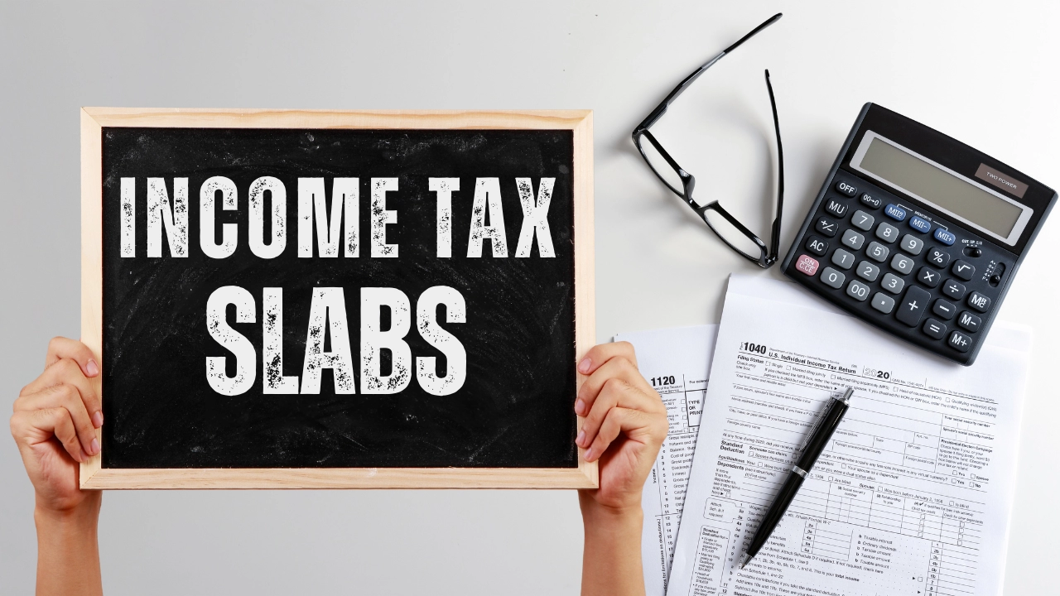
News Analysis on Union Budget 2024-25 New Tax Regime

Slide 3

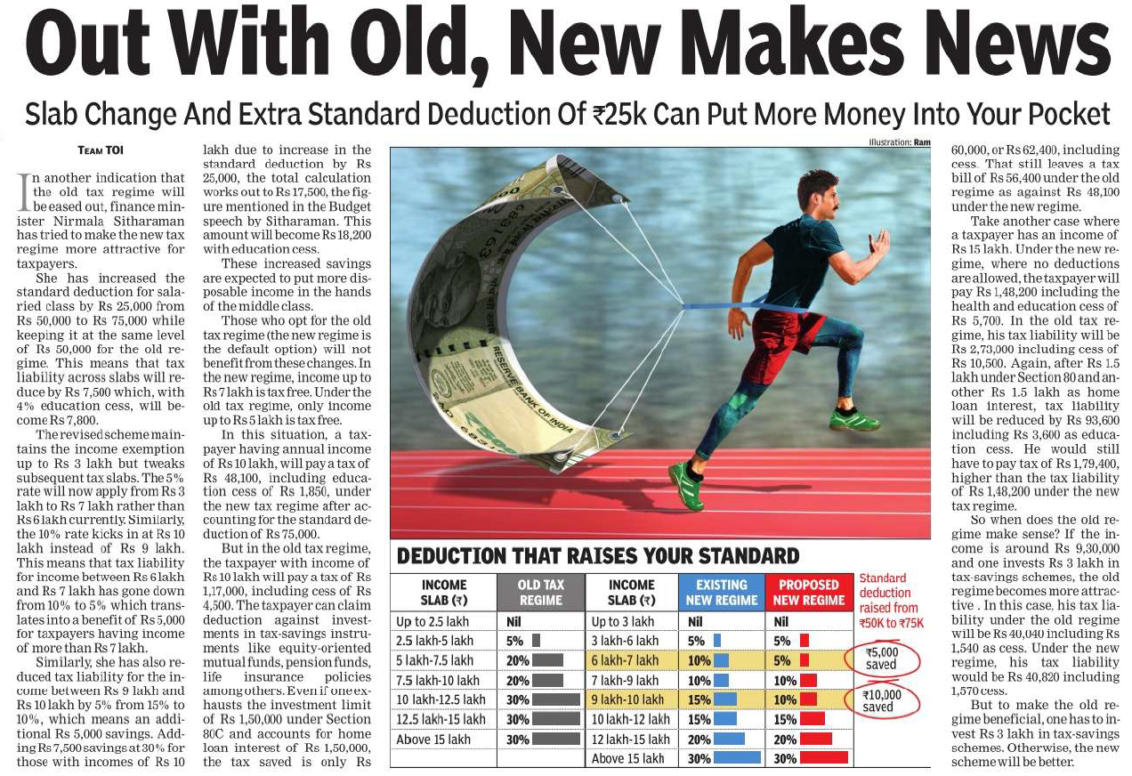
Changes to the New Tax Regime
Increased Standard Deduction: The standard deduction for salaried individuals has been raised from Rs 50,000 to Rs 75,000.
Revised Tax Slabs: Tax slabs have been adjusted to make the new tax regime more attractive.
Income up to Rs 3 lakh: Tax-free
Income between Rs 3 lakh and Rs 7 lakh: Taxed at 5%
Income between Rs 7 lakh and Rs 10 lakh: Taxed at 10%
Income between Rs 10 lakh and Rs 12 lakh: Taxed at 15%
Income between Rs 12 lakh and Rs 15 lakh: Taxed at 20%
Income above Rs 15 lakh: Taxed at 30%

Slide 4

Impact on Taxpayers
Potential Savings: Salaried individuals can save up to Rs 17,500 annually under the new tax regime due to the combined effect of the increased standard deduction and revised tax slabs.
Middle Class Benefits: The changes are expected to put more disposable income in the hands of the middle class.
Comparison with Old Regime: The article compares tax liabilities under the new and old tax regimes for different income levels, considering factors like investments and deductions.
Choosing the Right Regime: The decision to opt for the new or old tax regime depends on individual income, investments, and deductions.

Slide 5

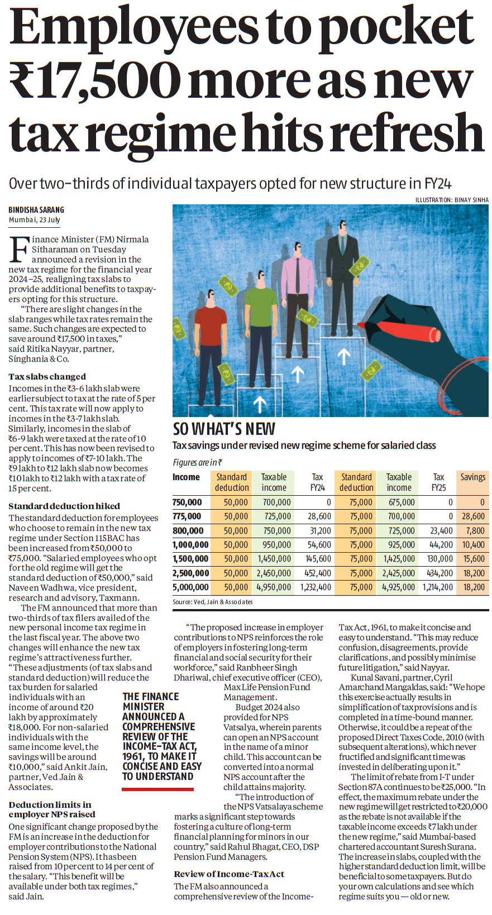
New Tax Regime Changes
Increased Standard Deduction: The standard deduction for salaried employees opting for the new tax regime has been raised from Rs 50,000 to Rs 75,000.
Revised Tax Slabs: The tax slabs have been adjusted. The 5% tax rate now applies to income between Rs 3 lakh and Rs 7 lakh, and the 10% rate applies to income between Rs 7 lakh and Rs 10 lakh.
Potential Tax Savings: These changes are expected to result in tax savings of around Rs 17,500 for salaried individuals with an income of around Rs 7.2 lakh.

Slide 6
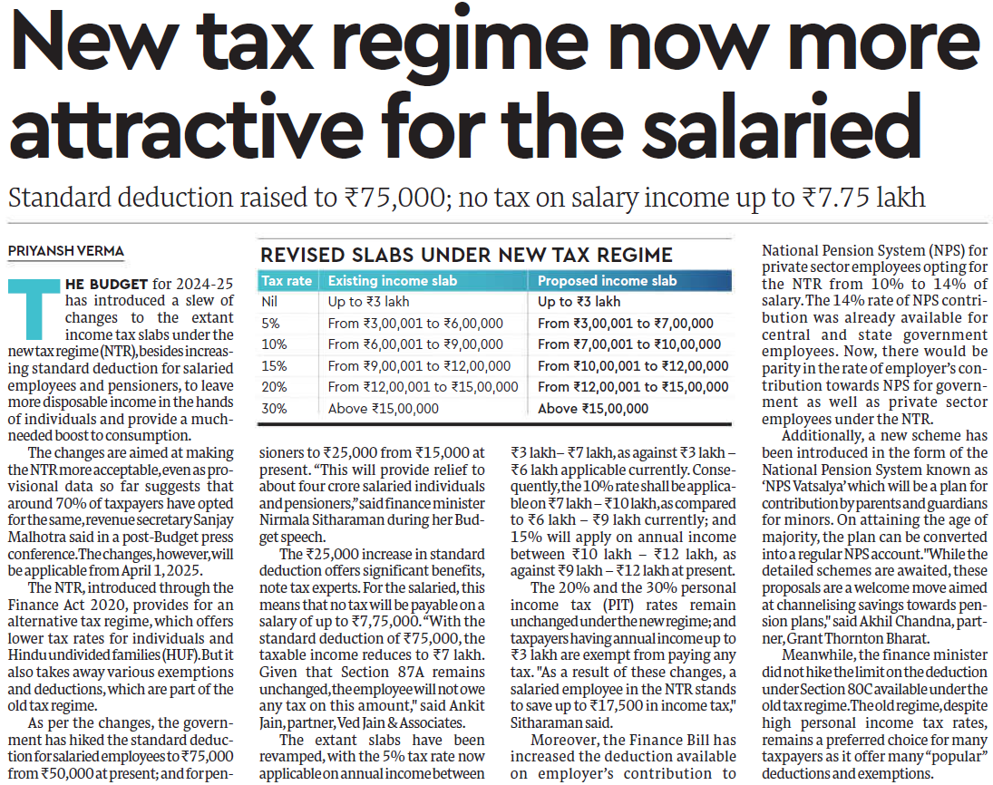
Key Points
NPS Benefits: The government has increased the employer's contribution to the National Pension System (NPS) for private sector employees opting for the new tax regime from 10% to 14%.
NPS Vatsalya Scheme: A new NPS scheme called 'NPS Vatsalya' has been introduced, allowing parents or guardians to open NPS accounts for minors.
Comparison with Old Regime: The article mentions that while the new tax regime offers lower tax rates, it also removes several deductions and exemptions available under the old regime. Many taxpayers still prefer the old regime due to these benefits.

Slide 7

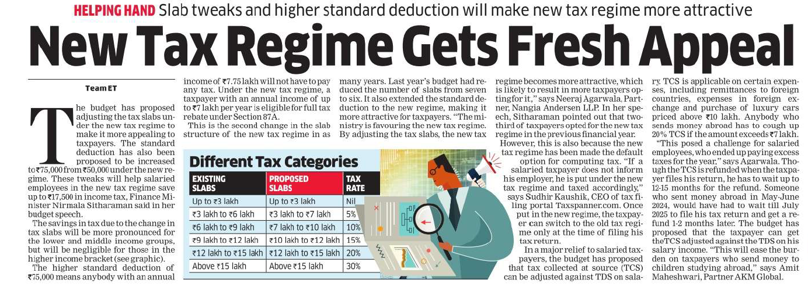
Key Points
Previous Changes: Last year's budget reduced the number of tax slabs and extended the standard deduction to the new regime.
Popularity of New Regime: Two-thirds of taxpayers opted for the new tax regime in the previous financial year, partly because it was the default option.
Challenges of New Regime: Salaried taxpayers who didn't inform their employers opted for the new regime by default and might have ended up paying more tax.
TCS Adjustment: The budget proposes allowing Tax Collected at Source (TCS) to be adjusted against Tax Deducted at Source (TDS) on salary income, easing the burden for those sending money abroad.

Slide 8

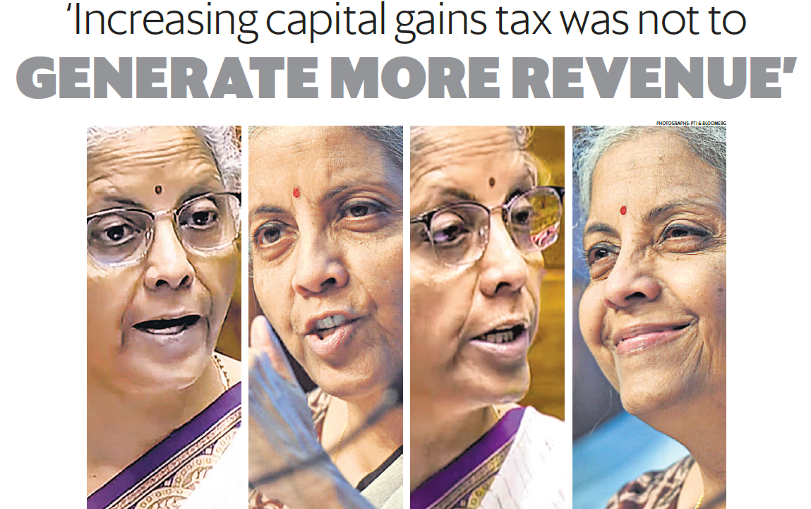

Slide 9
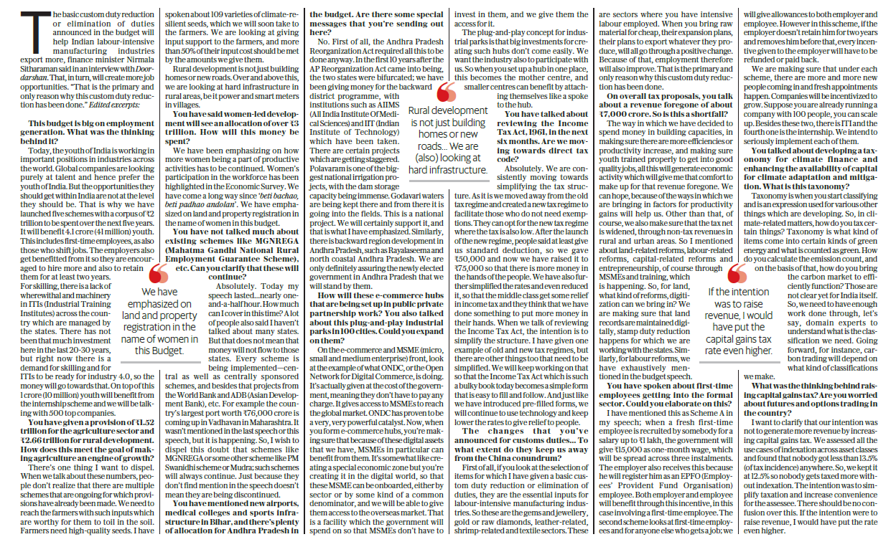
Key Points:
Simplification: The government aimed to simplify the tax structure by treating different asset classes similarly.
Fairness: The changes were made to ensure a fair tax incidence across various asset classes.
No Disadvantage: The minister emphasized that no taxpayer would be worse off due to the changes.
Additional Insights: The government conducted a thorough analysis of various scenarios before implementing the changes.
The focus was on ensuring that everyone pays at least 13.5% tax, considering indexation.

Slide 10
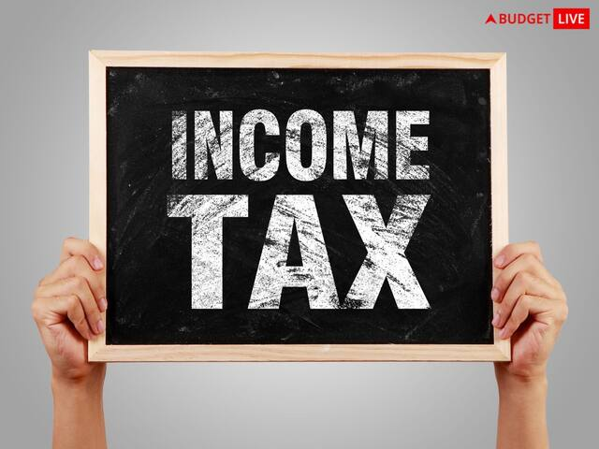
SUMMARY
Government has revamped the tax regime to incentivize more taxpayers to use it, with potential tax savings. Individuals should assess their finances to choose wisely.
Changes aim to attract more taxpayers, especially employees, with increased standard deduction and modified tax slabs for significant tax relief.
Careful calculation is urged to find the best option. Efforts to make the tax regime more appealing for salaried individuals include adjustments like the increased standard deduction and revised tax slabs.
Despite potential tax savings, careful evaluation of personal financial situations is crucial. Changes to the tax regime are designed to make it more enticing for taxpayers, particularly employees, with increased standard deduction and modified tax slabs for tax relief. Taxpayers should evaluate both regimes to determine the best choice.

Slide 11

THANK YOU

